Slide 1
The Artificial Intelligence trainer
เทรนเนอร์ อัจฉริยะ
Presented by: Aditep Campira

Slide 2
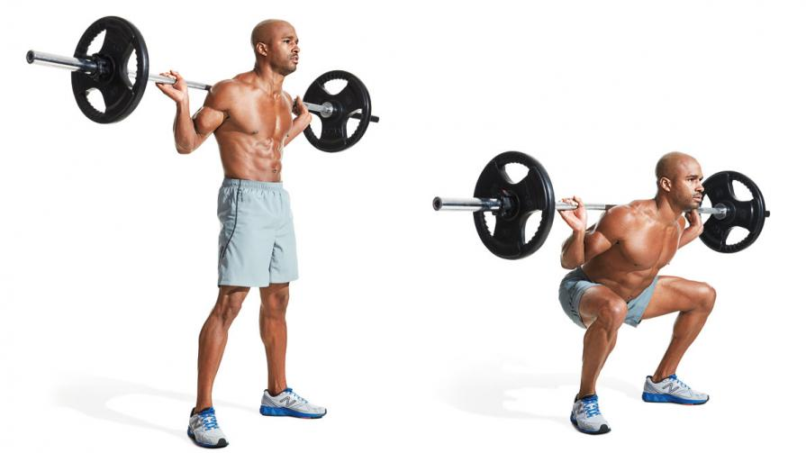
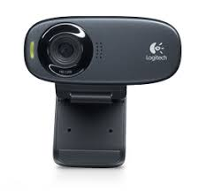
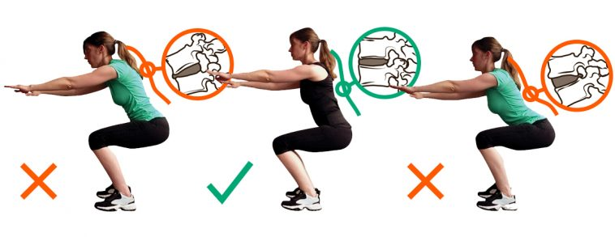
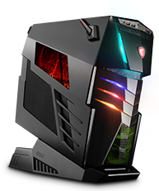
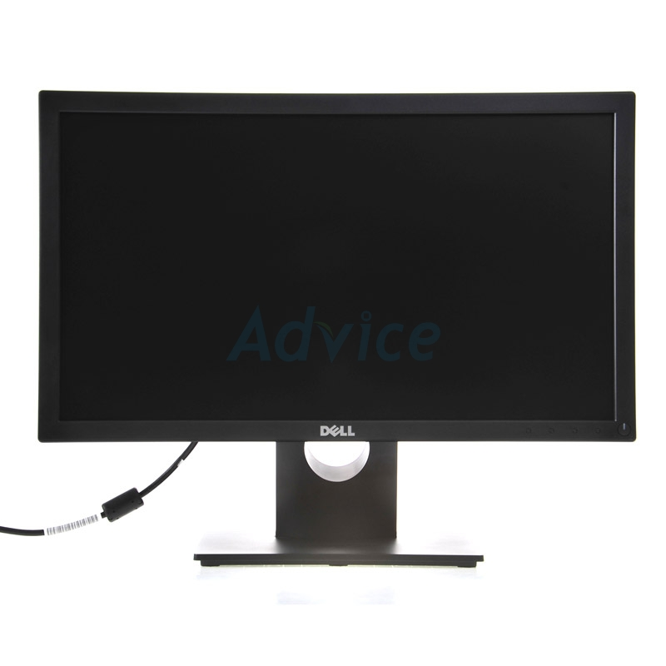
Input
(Webcam , Pictures , Vdo)
(Desktop application)
Process
(AI)
Output

Slide 3
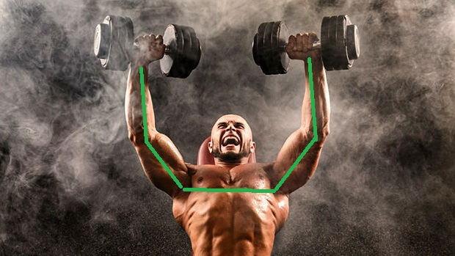

"pose_keypoints_2d":[582.349,507.866,0.845918,746.975,631.307,0.587007,...],
"face_keypoints_2d":[468.725,715.636,0.189116,554.963,652.863,0.665039,...],
"hand_left_keypoints_2d":[746.975,631.307,0.587007,615.659,617.567,0.377899,...],
"hand_right_keypoints_2d":[617.581,472.65,0.797508,0,0,0,723.431,462.783,0.88765,...]
"pose_keypoints_3d":[582.349,507.866,507.866,0.845918,507.866,746.975,631.307,0.587007,...],
"face_keypoints_3d":[468.725,715.636,715.636,0.189116,715.636,554.963,652.863,0.665039,...],
"hand_left_keypoints_3d":[746.975,631.307,631.307,0.587007,631.307,615.659,617.567,0.377899,...],
"hand_right_keypoints_3d":[617.581,472.65,472.65,0.797508,472.65,0,0,0,723.431,462.783,0.88765,...]
Webcam
OpenCV + Openpose
Data
Model 1
Error 10.3%
Data
Dev set
(.CSV)
Model 1
Model 2
Error 11.5%
1
2
3
Hidden Layer
Output Layer
Development set
Deep Learning
Training set
Error 10.3%
Model 1
Test set
Model
Test set

Slide 4

เพิ่มท่าออกกำลังกาย
ตรวจสอบท่าทางใน
การออกกำลังกาย
ลบท่าออกกำลังกาย
ผู้ใช้
ผู้ดูแลระบบ
แก้ไขท่าออกกำลังกาย

Slide 5
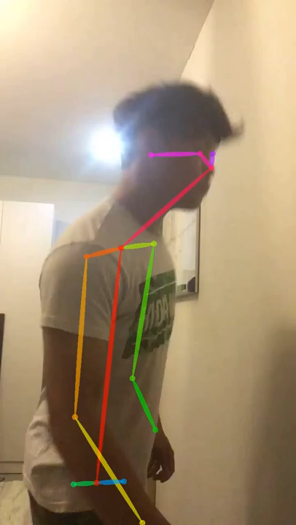
Input
OpenCV
+
OPENPOSE
Python API
JSON
"pose_keypoints_2d":[582.349,507.866,0.845918,746.975,631.307,0.587007,...],
"face_keypoints_2d":[468.725,715.636,0.189116,554.963,652.863,0.665039,...],
"hand_left_keypoints_2d":[746.975,631.307,0.587007,615.659,617.567,0.377899,...],
"hand_right_keypoints_2d":[617.581,472.65,0.797508,0,0,0,723.431,462.783,0.88765,...]
"pose_keypoints_3d":[582.349,507.866,507.866,0.845918,507.866,746.975,631.307,0.587007,...],
"face_keypoints_3d":[468.725,715.636,715.636,0.189116,715.636,554.963,652.863,0.665039,...],
"hand_left_keypoints_3d":[746.975,631.307,631.307,0.587007,631.307,615.659,617.567,0.377899,...],
"hand_right_keypoints_3d":[617.581,472.65,472.65,0.797508,472.65,0,0,0,723.431,462.783,0.88765,...]
Pose Output | keypoints 1 | keypoints 2 | keypoints 3 | keypoints 4 | keypoints 5 | keypoints 6
x0, "Nose" | 509.948 | 496.216 | 489.066 | 475.202 | 457.875 | 454.211
y0, "Nose" | 433.291 | 461.134 | 482.063 | 510.145 | 537.903 | 541.555
c0, "Nose" | 0.814327 | 0.79594 | 0.782292 | 0.763333 | 0.796098 | 0.774719
x1, "Neck" | 290.205 | 286.636 | 279.771 | 272.705 | 265.793 | 262.382
y1, "Neck" | 607.826 | 614.831 | 621.726 | 628.72 | 628.859 | 632.344
c1, "Neck" | 0.553807 | 0.531956 | 0.572829 | 0.577432 | 0.601575 | 0.576434
x2, "RShoulder" | 213.355 | 216.861 | 213.451 | 216.909 | 220.44 | 227.355
y2, "RShoulder" | 632.207 | 628.824 | 639.197 | 646.212 | 649.733 | 653.115
c2, "RShoulder" | 0.503318 | 0.518037 | 0.53368 | 0.558326 | 0.584394 | 0.603601
x3, "RElbow" | 185.54 | 199.386 | 206.46 | 209.818 | 206.408 | 202.915
y3, "RElbow" | 1012.72 | 1016.16 | 1012.59 | 995.193 | 984.697 | 974.325
CSV

Slide 6
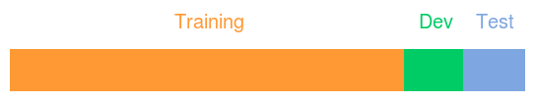
Data set
การแบ่งข้อมูล
Training set แบ่งข้อมูล 80 % เพื่อนำไป สอน model
Development set แบ่งข้อมูล 10 % เพื่อนำไปเลือก model ที่มีค่าผิดพลาดน้อยที่สุด
Test set แบ่งข้อมูล 10 % เพื่อนำไปทดสอบ model ว่ามีประสิทธิภาพหรือไม่

Slide 7

Deep learning
Y = w1 * X1 + w2 * y0 …… + bias
Data
x0
Linear combination
ReLu activation function
(.CSV)
Pose Output | keypoints 1 | keypoints 2 | keypoints 3 | keypoints 4 | keypoints 5 | keypoints 6
x0, "Nose" | 509.948 | 496.216 | 489.066 | 475.202 | 457.875 | 454.211
y0, "Nose" | 433.291 | 461.134 | 482.063 | 510.145 | 537.903 | 541.555
c0, "Nose" | 0.814327 | 0.79594 | 0.782292 | 0.763333 | 0.796098 | 0.774719
x1, "Neck" | 290.205 | 286.636 | 279.771 | 272.705 | 265.793 | 262.382
y1, "Neck" | 607.826 | 614.831 | 621.726 | 628.72 | 628.859 | 632.344
c1, "Neck" | 0.553807 | 0.531956 | 0.572829 | 0.577432 | 0.601575 | 0.576434
x2, "RShoulder" | 213.355 | 216.861 | 213.451 | 216.909 | 220.44 | 227.355
y2, "RShoulder" | 632.207 | 628.824 | 639.197 | 646.212 | 649.733 | 653.115
c2, "RShoulder" | 0.503318 | 0.518037 | 0.53368 | 0.558326 | 0.584394 | 0.603601
x3, "RElbow" | 185.54 | 199.386 | 206.46 | 209.818 | 206.408 | 202.915
y3, "RElbow" | 1012.72 | 1016.16 | 1012.59 | 995.193 | 984.697 | 974.325
y0
∑
R
c0
1
2
3
x1
Hidden Layer
Output Layer
Deep Learning
Training set
Input Layer
ระบุว่าท่านี้คือท่าอะไร
+
ท่านี้ทำถูกต้องไหม
Supervised Machine Learning

Slide 8
Development set
Test set
Dev set
Model 1
Error 10.3%
Error 11.5%
Error 9.8%
Model 2
Model 1
Test set
Model 3
Error 11.9%
Test set
Development set
เลือก model ที่มีค่าผิดพลาดน้อยที่สุด
ทดสอบ model ว่ามีประสิทธิภาพหรือไม่

Slide 9
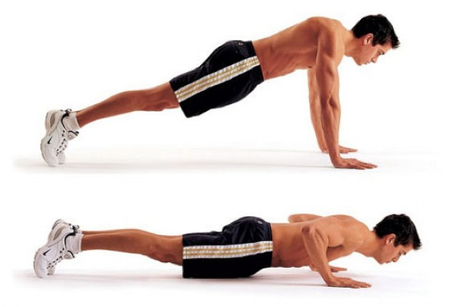
PUSH-UP 95 %
PUSH-UP 75%
OpenCv + Openpose + Model

Slide 10
